Slide 1
Smart Backup & Restore System
Version Control Based Data Protection System
Presented by Student

Slide 2
Problem Statement
Many organizations rely on basic or outdated backup mechanisms.
These systems:
Do not maintain file version history
Make it difficult to track changes over time
Lack efficient recovery options
As a result:
Data loss becomes irreversible
Recovery processes are time-consuming and inefficient

Slide 3
Objective
Design a secure and scalable backup system
Implement version control for files
Allow users to restore any previous version easily
Provide a timeline view of all backup activities
Detect and avoid duplicate file storage
Suggest optimal backup frequency using intelligent analysis

Slide 4
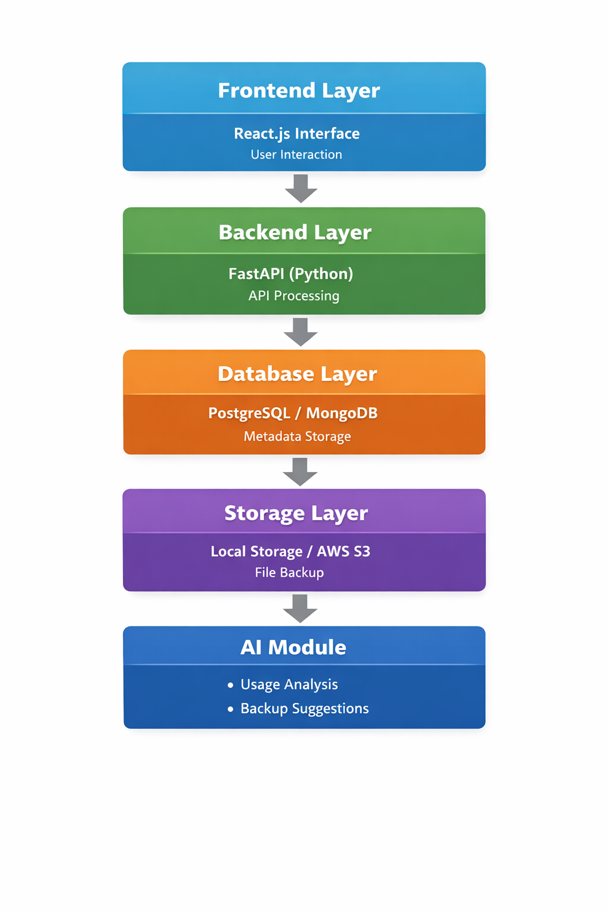
System Architecture

Slide 5
Key Features
Secure File Upload & Storage
Version Control System
Restore to Previous Versions
Backup Timeline Visualization
Duplicate File Detection
Smart Backup Suggestions using AI

Slide 6
Smart Backup Suggestion
System analyses :
File usage frequency
Modification patterns
Based on analysis :
Suggests Daily Backup
Suggests Weekly Backup
Suggests Monthly Backup
Enhances efficiency and automation

Slide 7
Conclusion
The system provides a comprehensive backup solution
Version control ensures data reliability and safety
Intelligent suggestions improve system efficiency
Suitable for both small and large-scale applications

